Slide 1
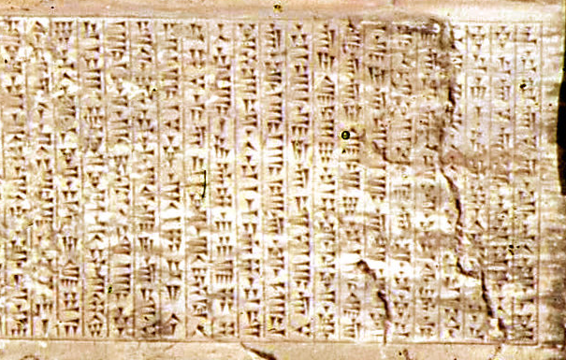
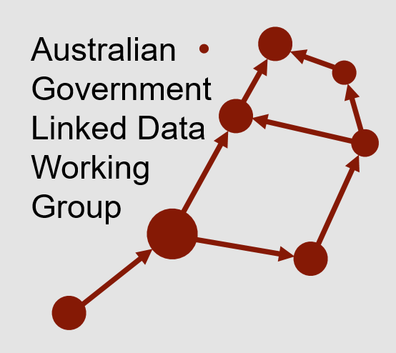

Persistent URIs for the Australian Govt.
https://w3id.org/
http://purl.org/
http://environment.data.gov.au/
http://linked.data.gov.au/
Ashurbanipal’s clay tablet library (650BC) had index tablets pointing to content. Both indexes and content still exist!
How long will I URIs last?
Simon Cox
CSIRO Research Scientist & Member of the Australian Government Linked Data Wrking Group

Slide 2
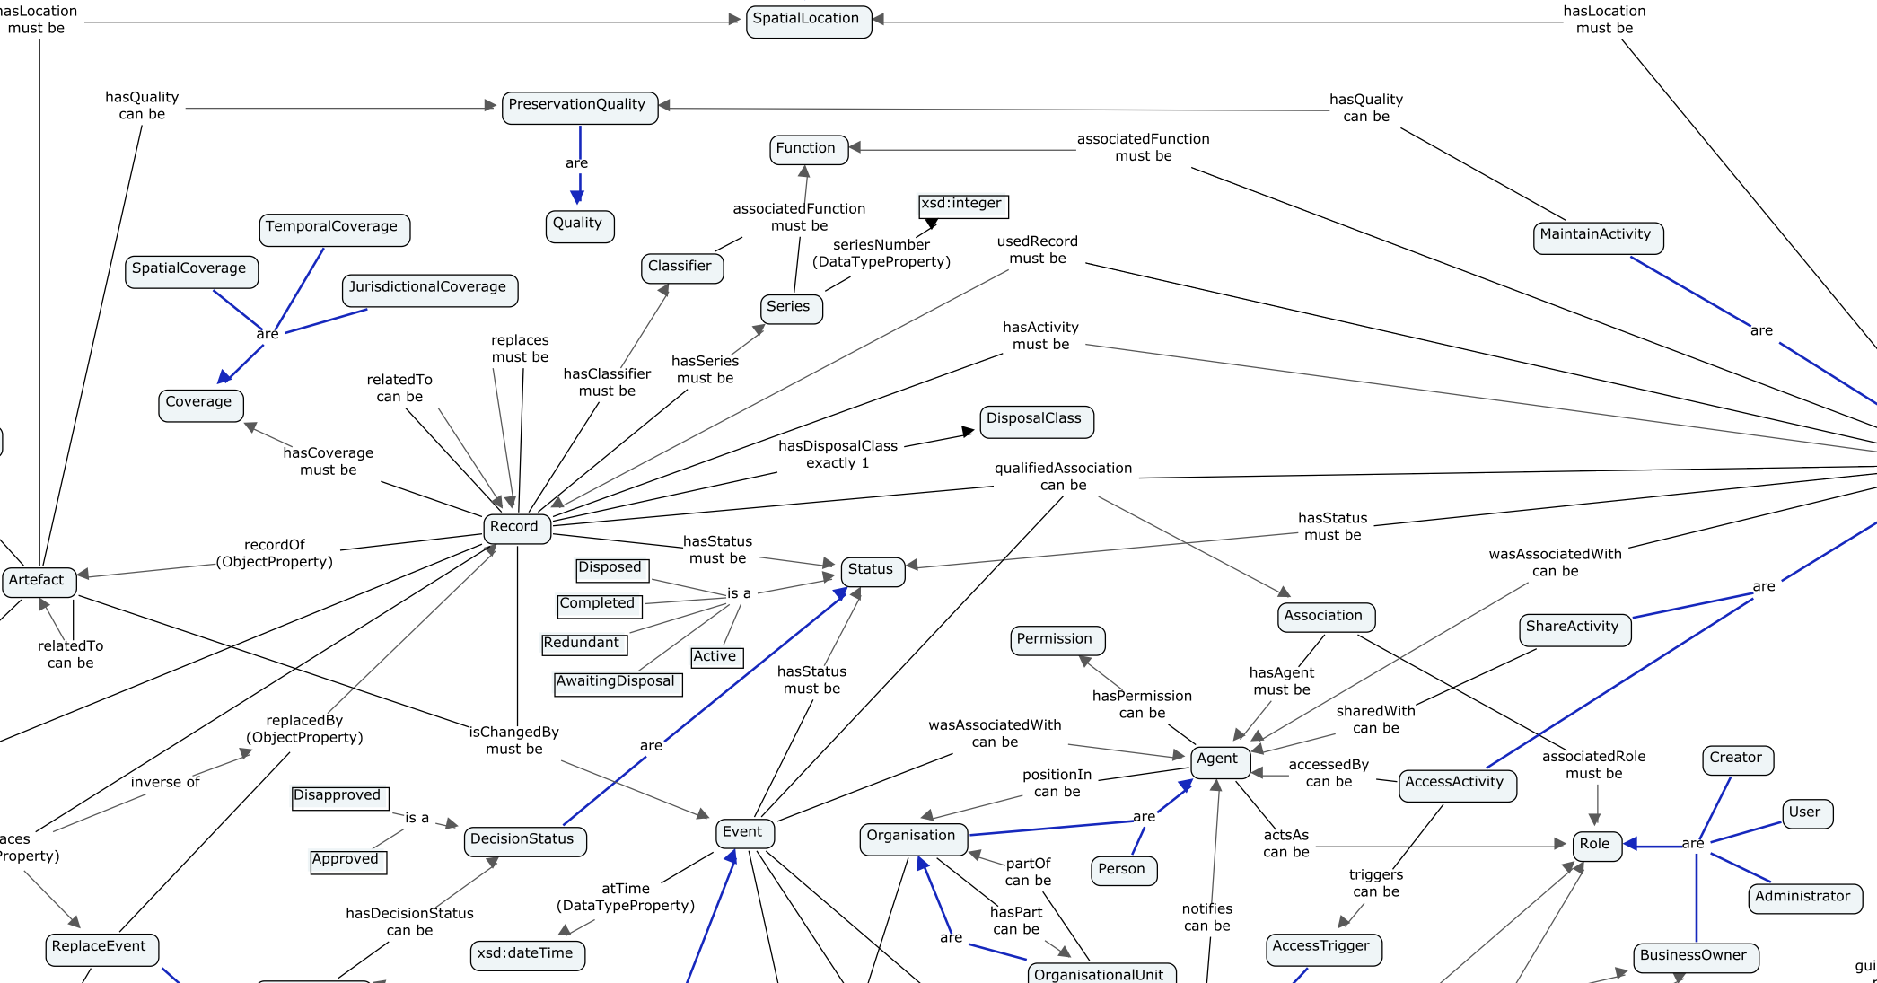
Outline
The Aust Govt Linked Data WG
AGLDWG PIDs
Initial arrangements
New arrangements

Slide 3














Australian Government Linked Data WG
Community of Commonwealth Government experts and champions, with invited non-voting participation of individuals, corporations and other entities.
Established in August 2012, with strong growth in membership since the Government released the outcomes of an inquiry on Data Availability and Use in the Australian Government.
No official Government mandate or related legislation, but a community of practice that promotes and represents a series of federal Government entities who seek to implement and use Linked Data technologies for the betterment of Australian Government data sharing.
Several members have signed an MoU to support the use and persistence of linked.data.gov.au URIs.

Slide 4
Australian Government Linked Data WG
Community of Commonwealth Government experts and champions, with invited non-voting participation of individuals, corporations and other entities.
Established in August 2012, with strong growth in membership since the Government released the outcomes of an inquiry on Data Availability and Use in the Australian Government.
No official Government mandate or related legislation, but a community of practice that promotes and represents a series of federal Government entities who seek to implement and use Linked Data technologies for the betterment of Australian Government data sharing.
Several members have signed an MoU to support the use and persistence of linked.data.gov.au URIs.
May change soon!

Slide 5
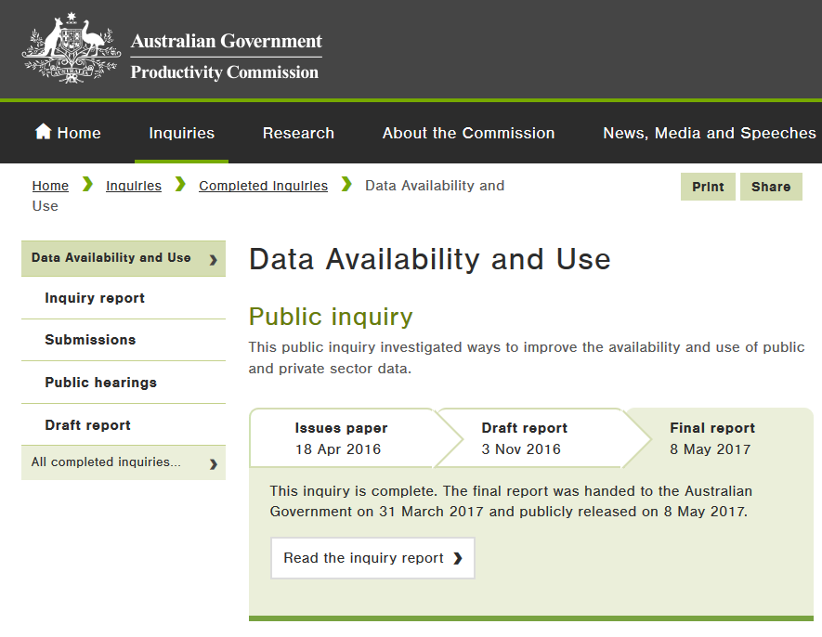
Things the AGLDWG Does
Facilitate the Aust Govt LD community
Engage with WoG data initatives
Manage persistent URIs for resources
and provide Guidelines for their use
Starting to register Linked Data resources
Datasets
Ontologies
Others…

Slide 6
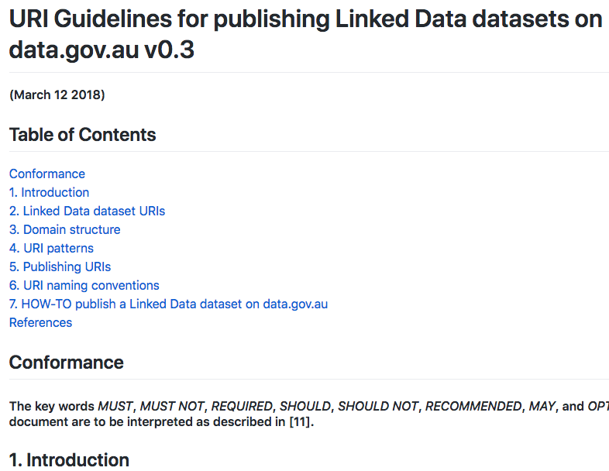
AGLDWG PIDs – Initial Arrangements
It is seen as essential for useful Linked Data to have persistent URIs
A PID regime started in 2013 provided for URIs within 26 subdomains of data.gov.au:
Top-level AGIFT terms used to segment management
environment
maritime
infrastructure
…
Other domain segementation vocabs considered, e.g. COFOG
Regime has run until now
The non-AGIFT subdomain reference.data.gov.au added in 2015 to cater for general LD resources
Only environment.data.gov.au has been well utilised, reference a little bit

Slide 7
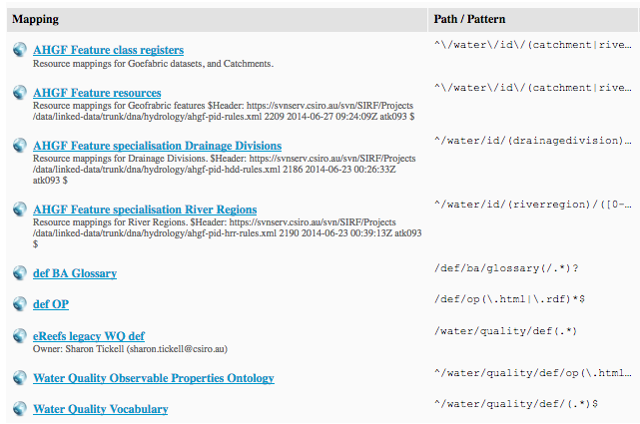
AGLDWG PIDs – Initial Arrangements
{environment, reference, infrastructure}.data.gov.au managed with the PID Svc tool
A CSIRO-developed management UI for a proxy server
Scales to large numbers of PID mappings
Can be edited without low-level server access
Individual resources (ontology files) and whole collections of resources (APIs) have been allocated persistent URIs
Important datasets include: ACORN-SAT & Geofabric
The UI of the PID Svc managing environment.data.gov.au
Important definitional resources include:
AGIFT
Dataset Ontology
BA Glossary

Slide 8
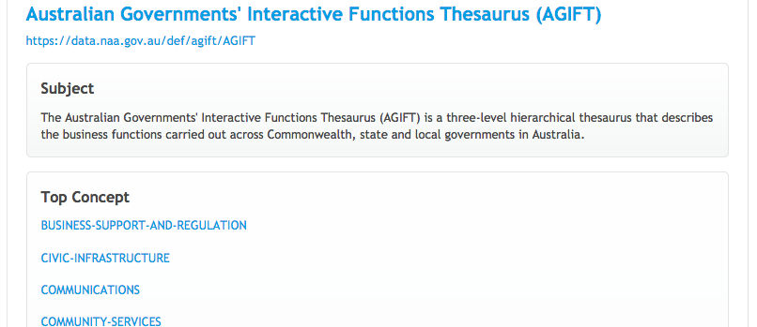
AGLDWG PIDs – Initial Arrangements
Questions about how to deal with non-AGIFT terms were always anticipated
In 2017, URIs about spatial data were requested for the Linked Data version of the Geocoded National Address File (G-NAF: http://gnafld.net)
With ‘statictics’ being added to AGIFT, ‘spatial’ was requested and ultimately received
A need to do things differently to AGIFT management segmentation was perceived
Some members of the WG felt uncomfortable with thematic classifiers in URIs, even for management
The National Archive’s AGIFT as an online vocabulary

Slide 9
AGLDWG PIDs – New Arrangements
Aims of the New Arrangements:
Work within a new MoU arrangement across agencies to lock down a namespace
Avoid inticating classification of resources in URI
Avoid constricting top-level vocabulary
Make 1st round allocation eash
Anyone can easily get a dataset or definitional PID
Provide for a 2nd-round of class-based register URIs
Maximally re-use top-level registers for resources of the same type

Slide 10
AGLDWG PIDs – New Arrangements
New PID URI arrangements proposed in Feb, 2018. Currently under test
Proposed:
linked.data.gov.au to be used for all PIDs
No other subdomains used
The National Archive’s AGIFT as an online vocabulary

Slide 11
AGLDWG PIDs – New Arrangements
New PID URI arrangements proposed in Feb, 2018. Currently under test
Proposed:
linked.data.gov.au to be used for all PIDs
No other subdomains used
One reason for this was the Digital Transformation Office’s preferment of single-subdomain allocation for AGLDWG management
The National Archive’s AGIFT as an online vocabulary

Slide 12
AGLDWG PIDs – New Arrangements
New PID URI arrangements proposed in Feb, 2018. Currently under test
Proposed:
linked.data.gov.au to be used for all PIDs
No other subdomains used
Datasets to be allocated URIs at …/dataset/{NAME}
Definitional resources with URIs at …/def/{NAME}
Top-level registers at …/{CLASS-NAME}/
The National Archive’s AGIFT as an online vocabulary

Slide 13
AGLDWG PIDs – New Arrangements
New PID URI arrangements proposed in Feb, 2018. Currently under test
Proposed:
linked.data.gov.au to be used for all PIDs
No other subdomains used
Datasets to be allocated URIs at …/dataset/{NAME}
Definitional resources with URIs at …/def/{NAME}
Top-level registers at …/{CLASS-NAME}/
Individual items either within datasets or within top-level registers:
…/dataset/{NAME}/{REGISTER}/{ITEM-ID}
…/{CLASS-NAME}/{ITEM-ID}
The National Archive’s AGIFT as an online vocabulary

Slide 14
AGLDWG PIDs – New Arrangements
New PID URI arrangements proposed in Feb, 2018. Currently under test
Proposed:
linked.data.gov.au to be used for all PIDs
No other subdomains used
Datasets to be allocated URIs at …/dataset/{NAME}
Definitional resources with URIs at …/def/{NAME}
Top-level registers at …/{CLASS-NAME}/
Individual items either within datasets or within top-level registers:
…/dataset/{NAME}/{REGISTER}/{ITEM-ID}
…/{CLASS-NAME}/{ITEM-ID}
Anyone can get these by registering a dataset
You get these by registering things with accepted definitions

Slide 15
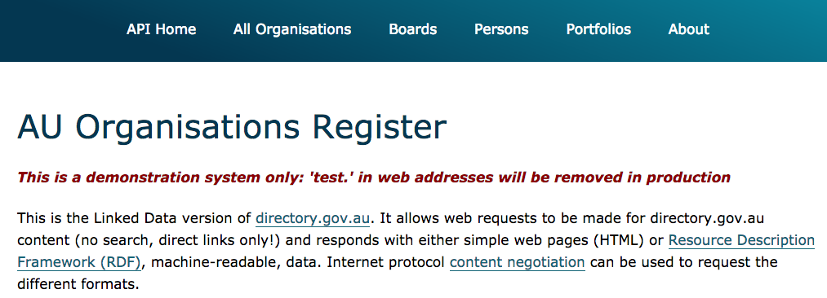
AGLDWG PIDs – New Arrangements
A dataset now in test: AU Orgs Register
Dataset: http://test.linked.data.gov.au/dataset/auorg

Slide 16
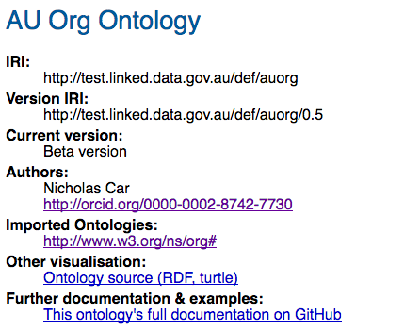
AGLDWG PIDs – New Arrangements
A dataset now in test: AU Orgs Register
Dataset: http://test.linked.data.gov.au/dataset/auorg
Ontology: http://test.linked.data.gov.au/def/auorg

Slide 17
AGLDWG PIDs – New Arrangements
A dataset now in test: AU Orgs Register
Dataset: http://test.linked.data.gov.au/dataset/auorg
Ontology: http://test.linked.data.gov.au/def/auorg
Don’t have to have an ontology per dataset, this one just does

Slide 18
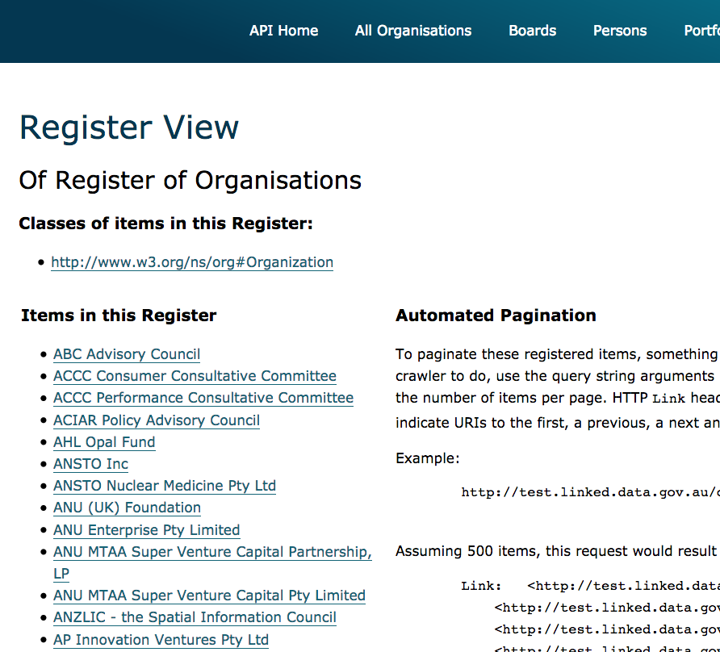
AGLDWG PIDs – New Arrangements
A dataset now in test: AU Orgs Register
Dataset: http://test.linked.data.gov.au/dataset/auorg
Ontology: http://test.linked.data.gov.au/def/auorg
Register of Organisations from AU Orgs Register: http://test.linked.data.gov.au/org/
Defined as org:Organization
Expected to share register with other orgs in the future

Slide 19
AGLDWG PIDs – New Arrangements
A dataset now in test: AU Orgs Register
Dataset: http://test.linked.data.gov.au/dataset/auorg
Ontology: http://test.linked.data.gov.au/def/auorg
Register of Organisations from AU Orgs Register: http://test.linked.data.gov.au/org/
Defined as org:Organization
Expected to share register with other orgs in the future
Things in the register could have any URI. The /org/ here is just for the register of things of a particular class

Slide 20
AGLDWG PIDs – New Arrangements
A dataset now in test: AU Orgs Register
Dataset: http://test.linked.data.gov.au/dataset/auorg
Ontology: http://test.linked.data.gov.au/def/auorg
Register of Organisations from AU Orgs Register: http://test.linked.data.gov.au/org/
Items in the AU Orgs Register dataset appear in top-level and 2nd-level registers:
…/org/ - org:Organisations
e.g. Australian Bureau of Statistics http://test.linked.data.gov.au/org/O-000928
…/dataset/auorg/subStructure/
sub-units within government organisations, e.g. http://test.linked.data.gov.au/dataset/auorg/subStructure/O-003289

Slide 21
AGLDWG PIDs – New Arrangements
Timeline:
Mar 2018: Proposed
May 2018: demonstrated
June 2018: New Arrangements URI Guidelines to be issued
July 2018: AGLDWG vote to proceed with New Arrangements
July 2018+: New Arrangement-style URIs allocated

Slide 22
Questions?
Contacts
AGLDWG: http://linked.data.gov.au
Nick: simon.cox@csiro.au

